Slide 1
Prediction of Traffic Accident Severity
Burger Wu

Slide 2

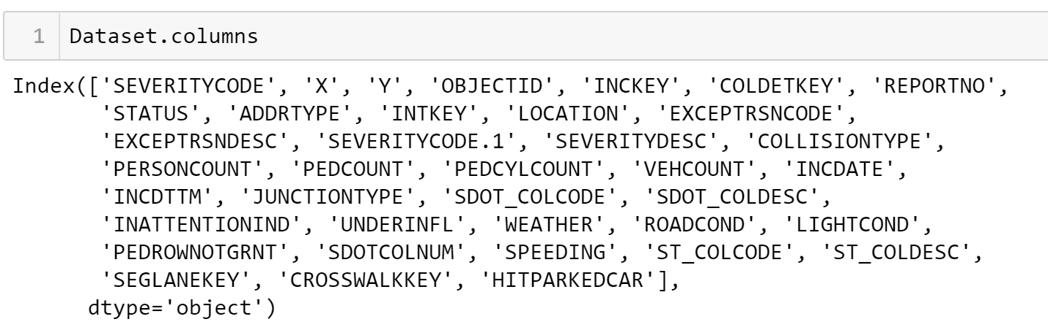
Introduction-Dataset
Our dataset contains 194673 labeled samples and 38 features

Slide 3
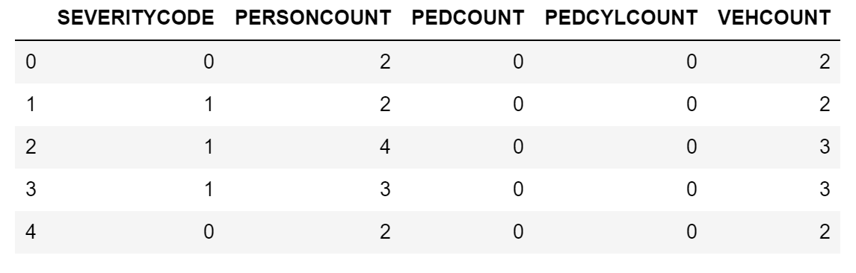
Introduction-Data Cleaning
1.Dataset Split-numerical and categorical
2.Data Cleaning(numerical)-deleting non-relevant columns
3.Data Cleaning(numerical)-detecting Nan or null values

Slide 4
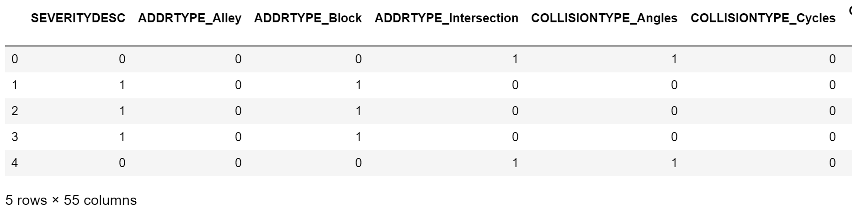
Introduction-Data Cleaning
4.Data Cleaning(categorical)-deleting non-relevant columns
5.If Nan or null → assume 0 in every dummy variables
6.Transform into dummy variables

Slide 5
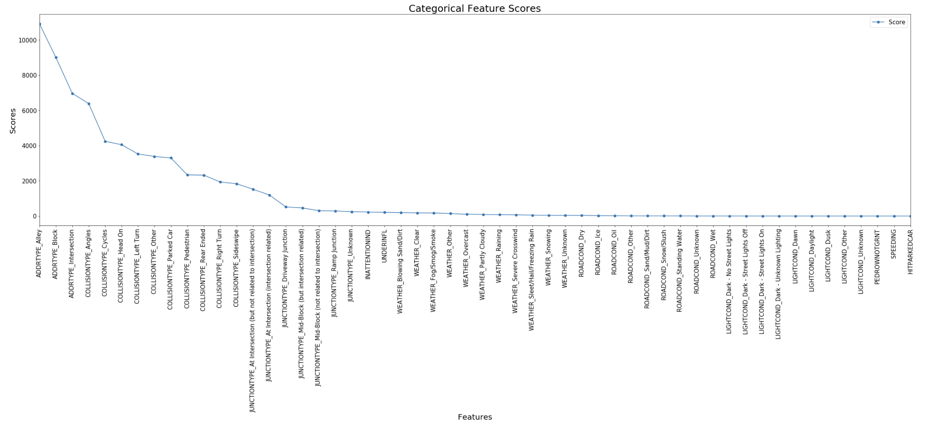
Introduction-Data Selection
According to correlation coefficient analysis, the correlation coefficient is reasonably not too low thus we choose all as modeling features.
For categorical dataset, we use selectKBest function to use scores to evaluate feature importance. There is a apparent turnign point, thus we choose features with scores higher than that point.

Slide 6
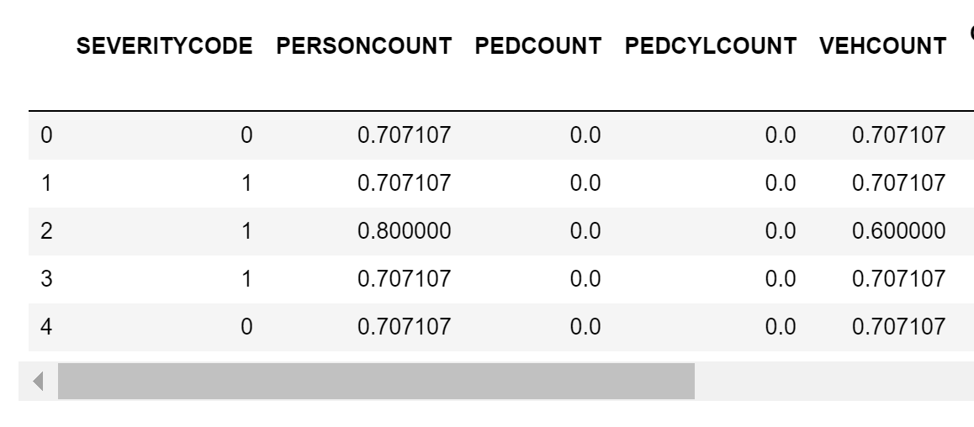
Introduction-Data Normalization
We normalize the numerical dataset to make sure all features are with same scale.

Slide 7
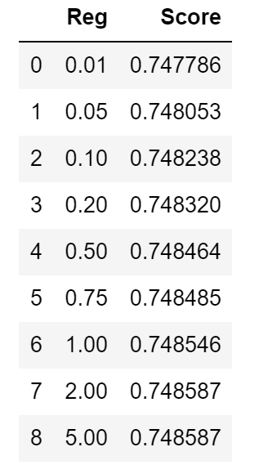
Exploration-Logistic Regression
Change regularization term
Regularization not so influential in this case

Slide 8
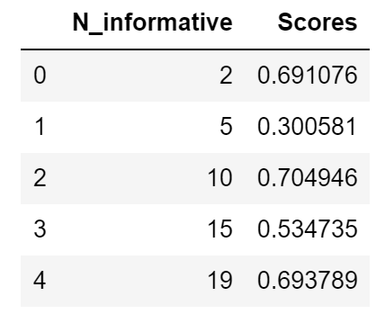
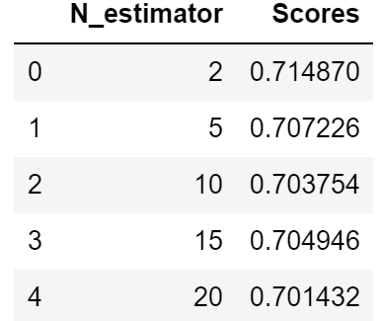
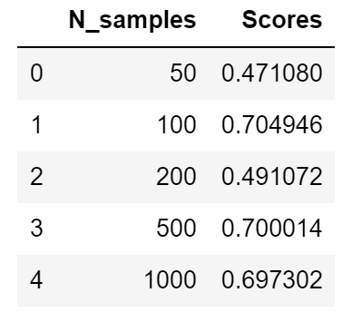
Exploration-SVM
Change n_informative, n_estimator and n_samples
n_informative, n_samples not trended.
N_estimator not influential

Slide 9
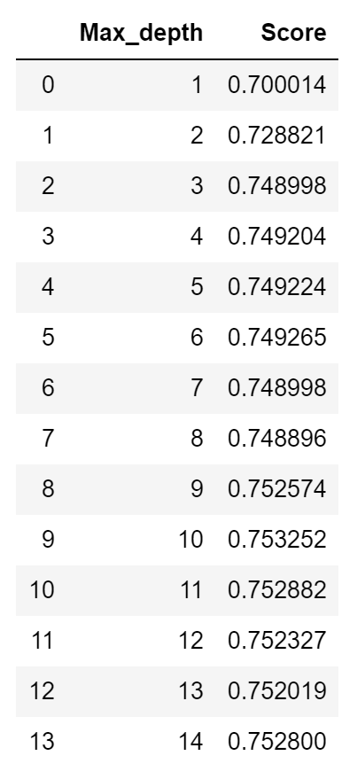
Exploration-Decision Tree
Change max depth
Score gradually grows and get stable as max_depth incraese

Slide 10
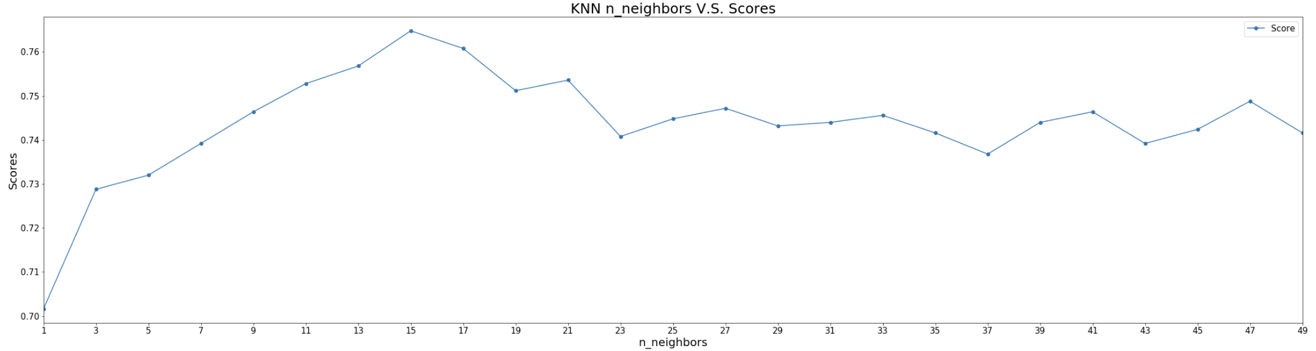
Exploration-KNN
Change K neighbors
Max at 15

Slide 11
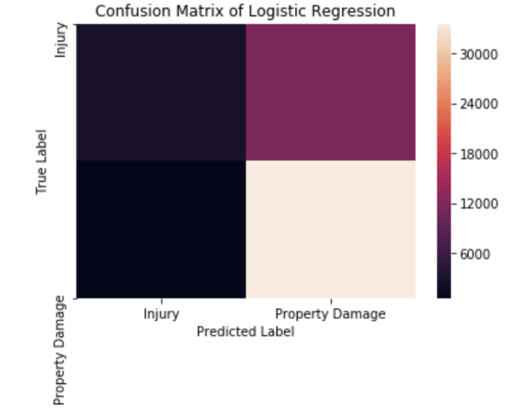
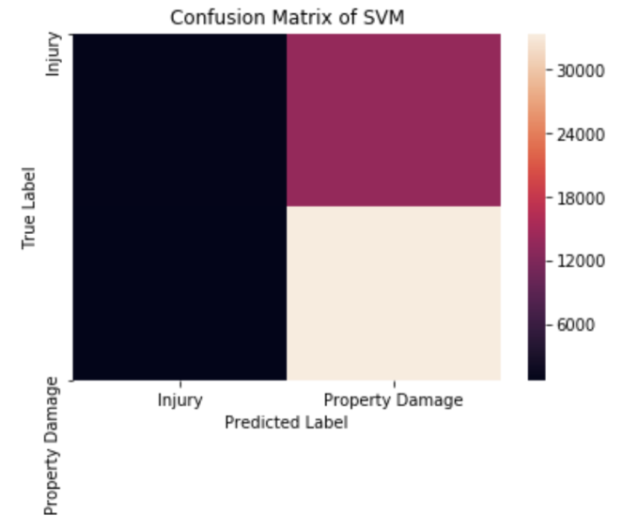
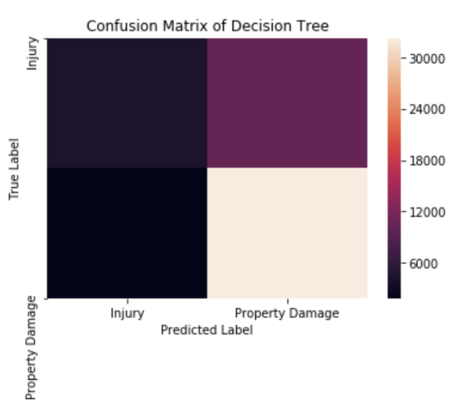
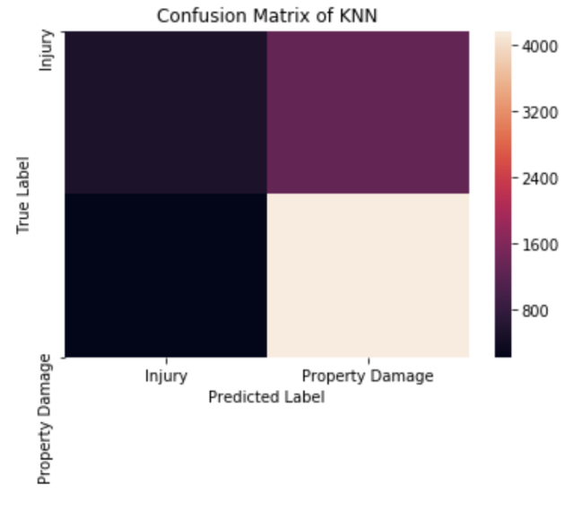
Confusion Matrix-Heatmap
Most algorithms do not bad job
SVM has higher false positive rate

Slide 12
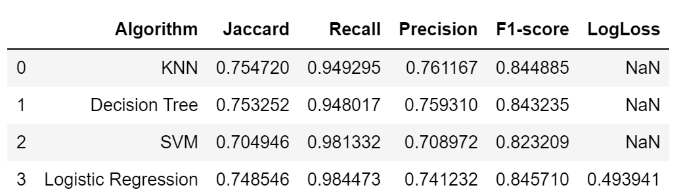
Classification Report
KNN-high accuracy and precision, but lower computation efficiency
Decision Tree-Middle class in every term, good as a comparable algorithm
SVM-Bad accuracy, low precision, low computation efficiency
Logistic-Decent accuracy, good f1-score, higher computation efficiency

Slide 13
Conclusion 1
SVM seems not a good choice for this application
KNN has best accuracy but somehow a bit lower recall. KNN could be a good choice for relatively small dataset.
Logistic regression has decent accuracy as well as good recall. Besides, logistic regression is relatively computation efficient, it may be good for larger dataset.
Decision tree has middle class performance at every term, thus it may be a safe choice if you do not know which algorithm to apply or you want an algorithm to compare with another. Also, decision tree may be good at larger dataset as well.

Slide 14
Conclusion 2
1. Computation efficiency may affect the performance. It will restricts us from having more training samples.
2. Nan or null values in categorical dataset may affect the real performance of our model. In our case, we assume those Nan or null cells to be 0 in every dummy variable.

